Slide 1
Restaurant Ratings Analysis
By: Bella Lin, Emilie Baek, Emily Bates, Makenzie Kalebick, Tara Grey

Slide 2
Outline
Business Problem
Data Description & Overview
Data Importation & Inspection
Data Cleaning
Data Joins
Visualizations
Conclusion and Recommendations

Slide 3
Business Problem
Customers in Mexico are curious which restaurants are the top rated based on different characteristics.
How we will assist:
Identify the top-rated restaurants
Assessing service rating, food quality rating, and overall rating
Analyze the features of restaurants based on different rating conditions
Average rating ≥ 1.75, top 10, etc.
Price, cuisine, alcohol served or not, dress code, ambience, etc.
Provide tailored recommendations for customers
Budget and preferences

Slide 4
Data Description & Overview
Restaurant Data:
Accepted methods of payment (2)
Cuisines (2)
Hours open (3)
Parking options (2)
Geographic information and other attributes (21)
Consumer Data:
Cuisines (2)
Payment method (2)
Varied consumer information - user profile (19)
Rating Data:
Ratings (5)
Data Source:
Medelln, R., & Serna, J. (2012, March 8). Restaurant & Consumer Data. UCI Machine Learning Repository. https://archive.ics.uci.edu/dataset/232/restaurant+consumer+data
Notes:
Speaker: Emily
(number of variables) in parentheses

Slide 5
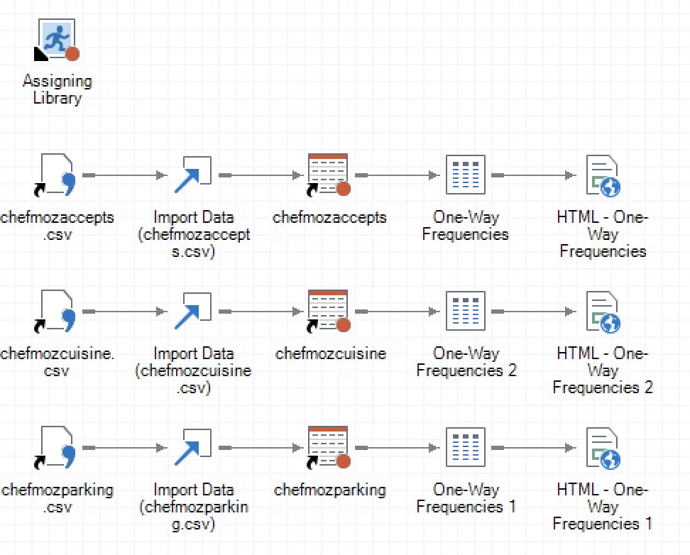
Data Importation & Inspection
Creating permanent library
Importing and storing files
One-Way Frequency Reports

Slide 6
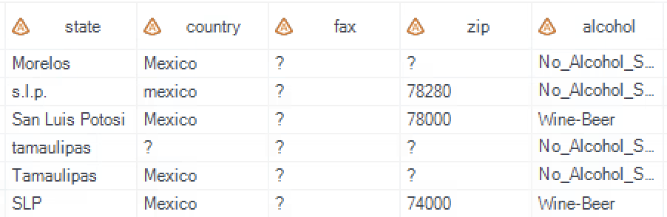
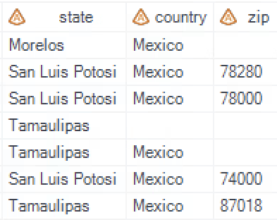
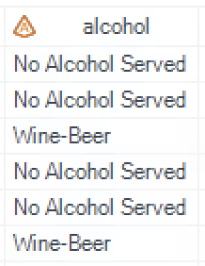
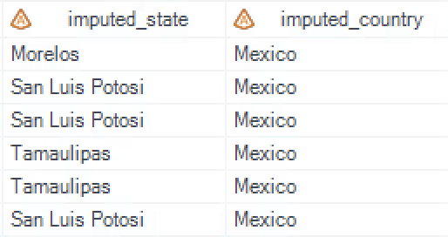
Data Cleaning
PROC SQL Queries:
Recoding ‘?’ to missing values
Recoding slp, s.l.p., SLP, etc. to San Luis Potosi
Applying PROPCASE() and UPCASE()
Discarding and rearranging variables
Replacing underscores with spaces
Imputing missing value for state and country

Slide 7
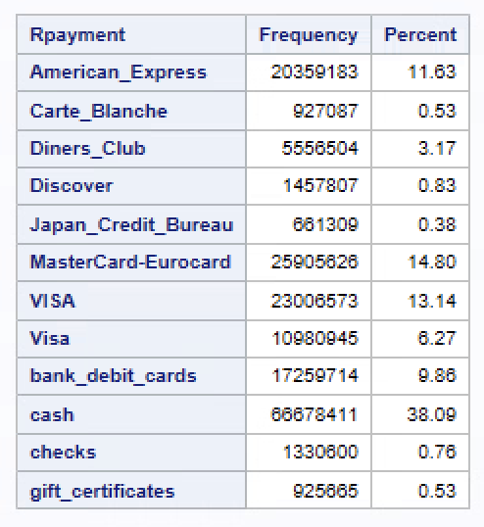
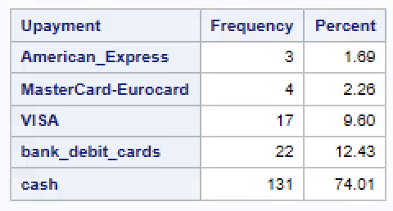
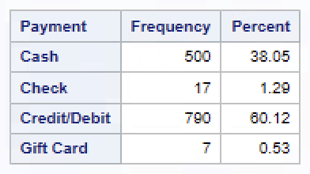
Data Cleaning
More PROC SQL Queries:
Grouping payment methods into 4 categories
One-Way Freq Reports Before: One-Way Freq Reports After:
Payment methods used by customers
Cleaned payment methods accepted by Restaurants
Payment methods accepted by restaurants

Slide 8
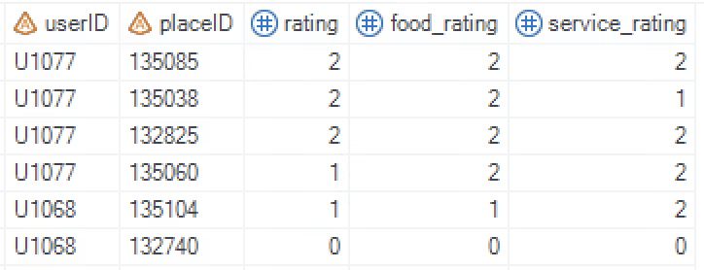
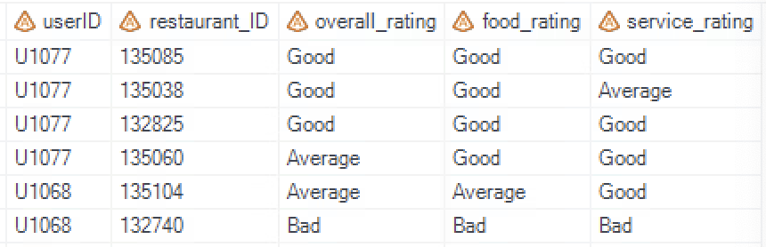
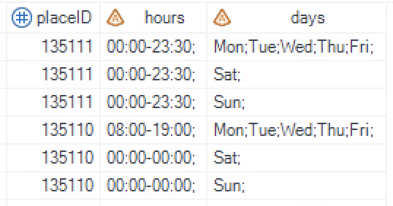
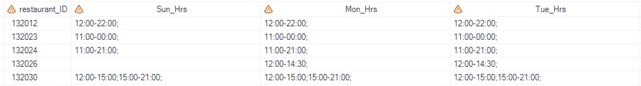
Data Cleaning
More PROC SQL Queries:
Formatting rating values
Transposing from long to wide format
Notes:
Speaker: Emily

Slide 9
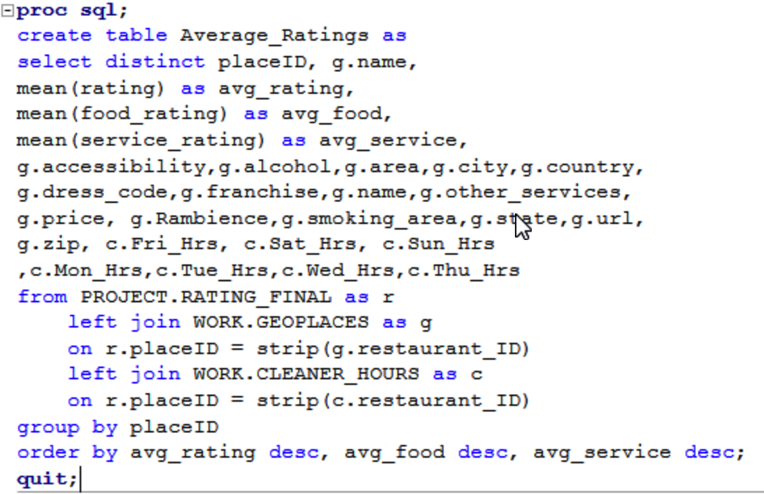
Joining our Data
Used place ID or restaurant ID for joining restaurant-related data
Used User ID for joining customer related data
Summarized ratings from each user as averages for each restaurant
Notes:
Speaker: Emily

Slide 10
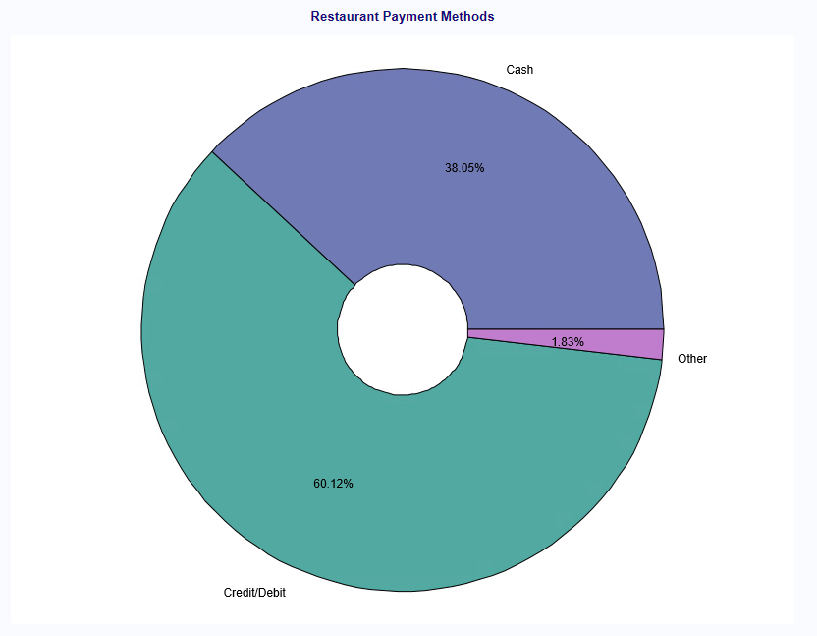
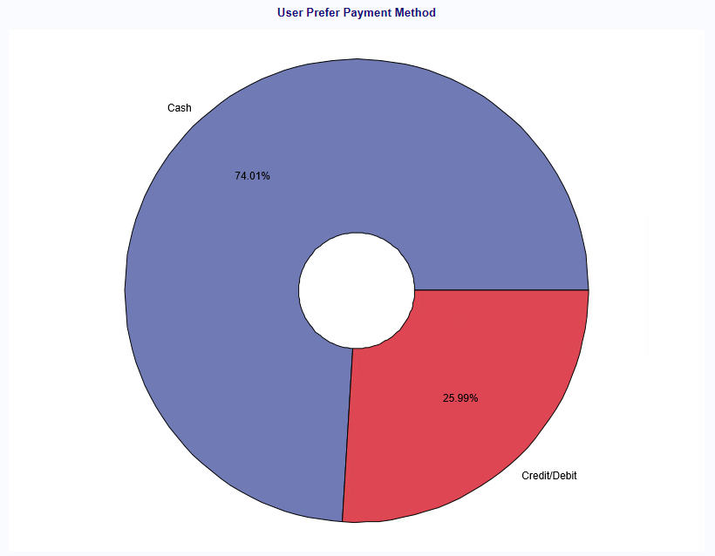
Payment Method Preference in 2012
Credit/Debit preferred payment type for restaurants
Other: checks, gift cards, etc.
For users, cash is the preferred payment type
Cash: 74% Credit/Debit: 26%
Notes:
These donut charts provide a visual for what payment methods are preferred from both the restaurants and the customers
Left - Restaurants prefer Debit/Credit at about 60% over Cash at about 38%
Right - Customers prefer to use cash at 74% over credit or debit which is about 26%
Something to note: This is data from 2012 - has probably changed since then especially since phones can now do a lot of this for us

Slide 11
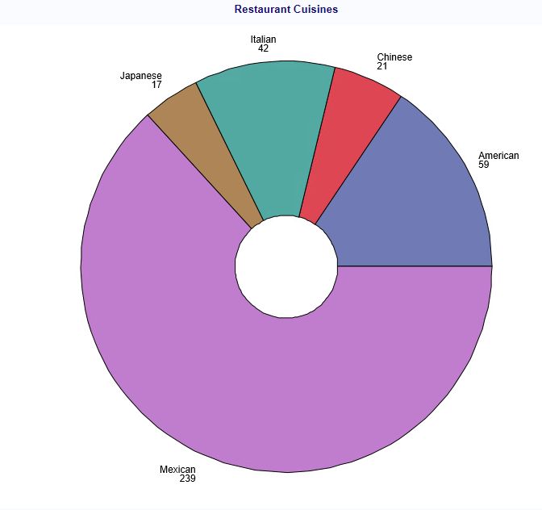
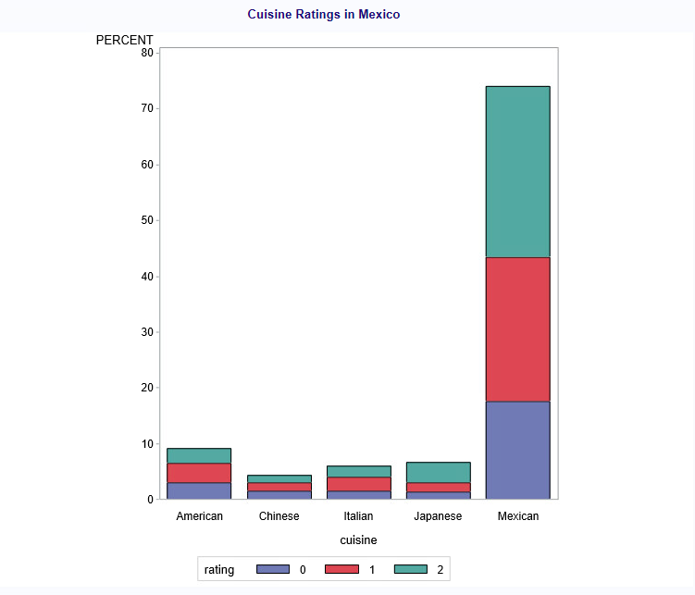
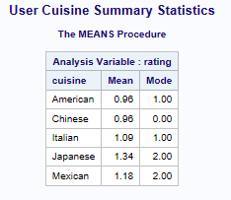
Cuisine Ratings
Top rated categories
Top rated is Japanese while the most common is Mexican
Donut Chart -> Amount of restaurants for these cuisines
Summary Statistics -> Average rating
Bar Graph -> Visual representation of the ratings for each category
Notes:
Here are a few charts for cuisine ratings
From our data, we were able to conclude that the top rated category is Japanese, but the most common cuisine is Mexican
The summary statistics table shows the average rating for each of these categories and the bar chart shows these ratings in a more detailed visualization

Slide 12
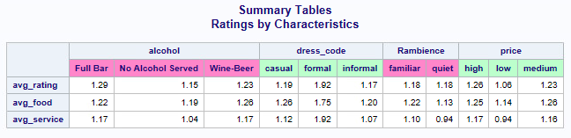
Ratings by Characteristics
Alcohol: Average rating is highest for full bar, lowest for no alcohol
Dress Code: Highest average rating for formal, lowest is for informal
Ambience: Equal ratings for familiar and quiet
Price: Higher priced restaurants have an overall higher rating with lower priced at the bottom
Highest rated characteristic overall… Formal Dress Code!
Notes:
Here we put together a summary table to showcase all of the ratings by characteristics in order to compare them…

Slide 13
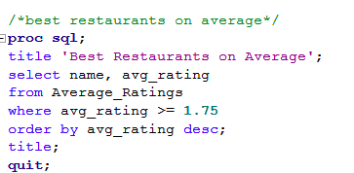
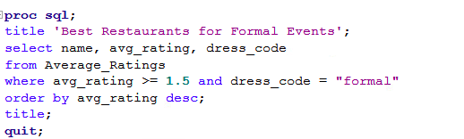
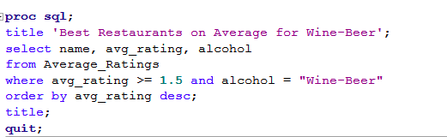
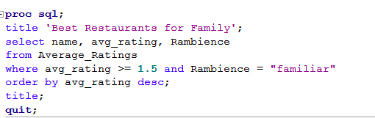
Restaurant Recommendations Based on Characteristics

Slide 14
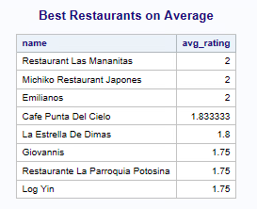
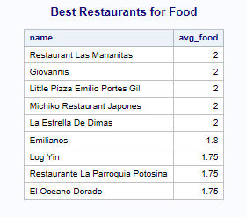
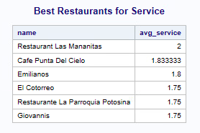
Best Restaurants Based on Ratings (rating>1.75)

Slide 15
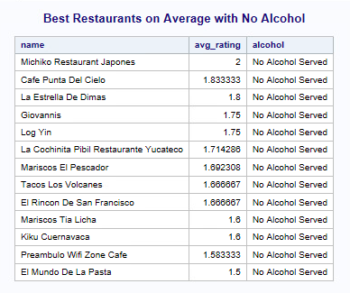
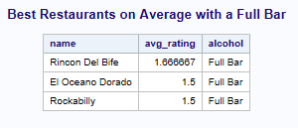
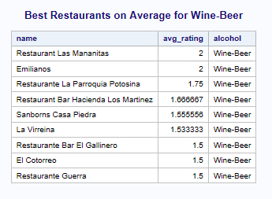
Best Restaurants Based on Alcohol (rating>1.5)

Slide 16
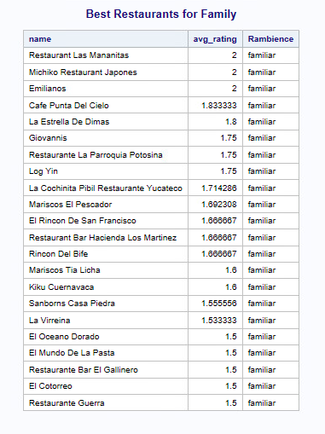
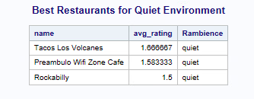
Best Restaurants Based on Ambience (rating>1.5)

Slide 17
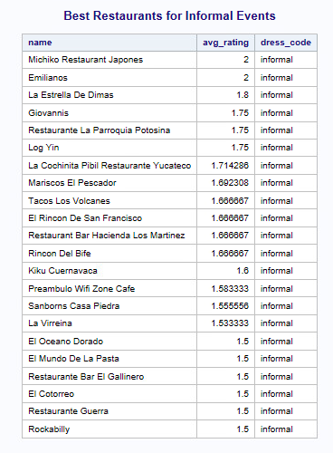

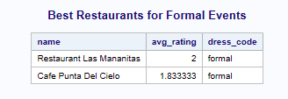
Best Restaurants Based on Dress Code (rating>1.5)

Slide 18
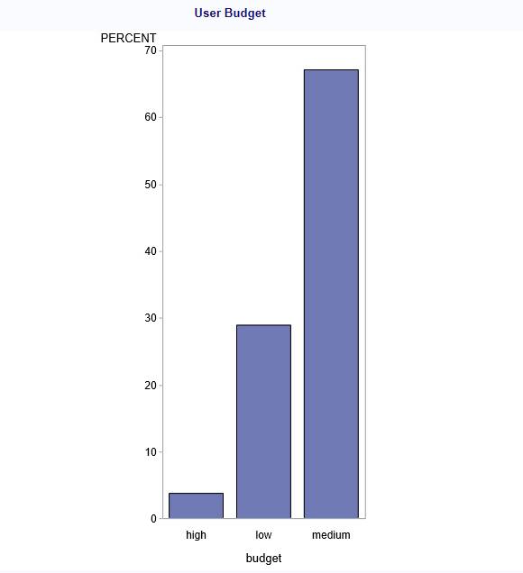
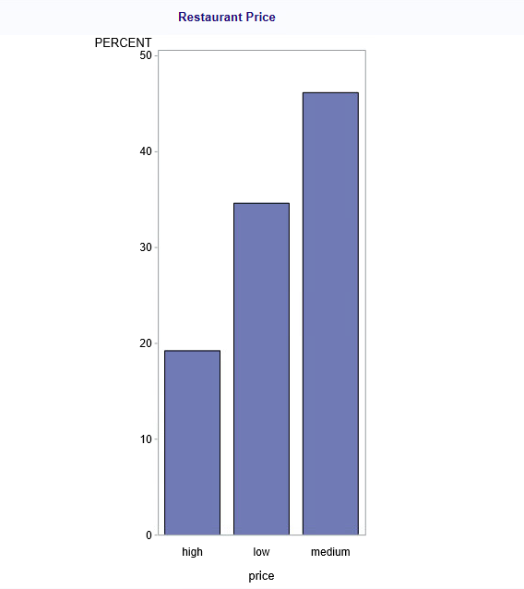
User Budget vs Restaurants Price

Slide 19
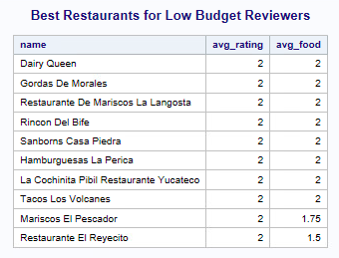
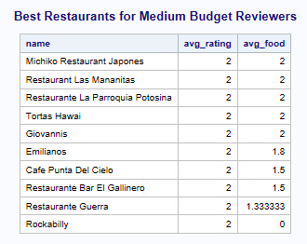
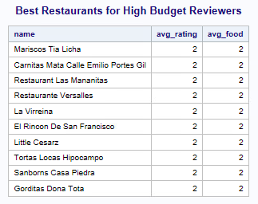
Best Restaurant Based on Budget

Slide 20
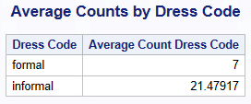
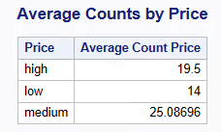
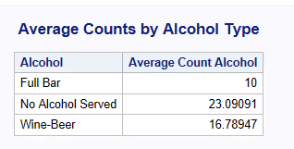
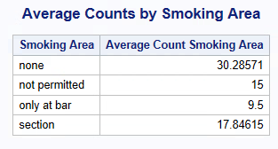
Analysis of Good Restaurants Attributes (Rating = 2)

Slide 21
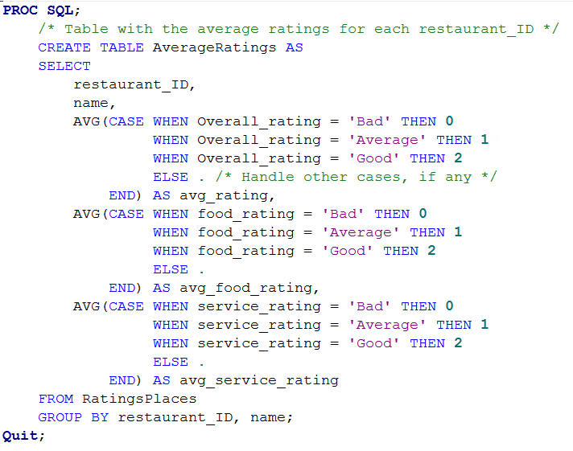
Subqueries to Calculate Average Ratings

Slide 22
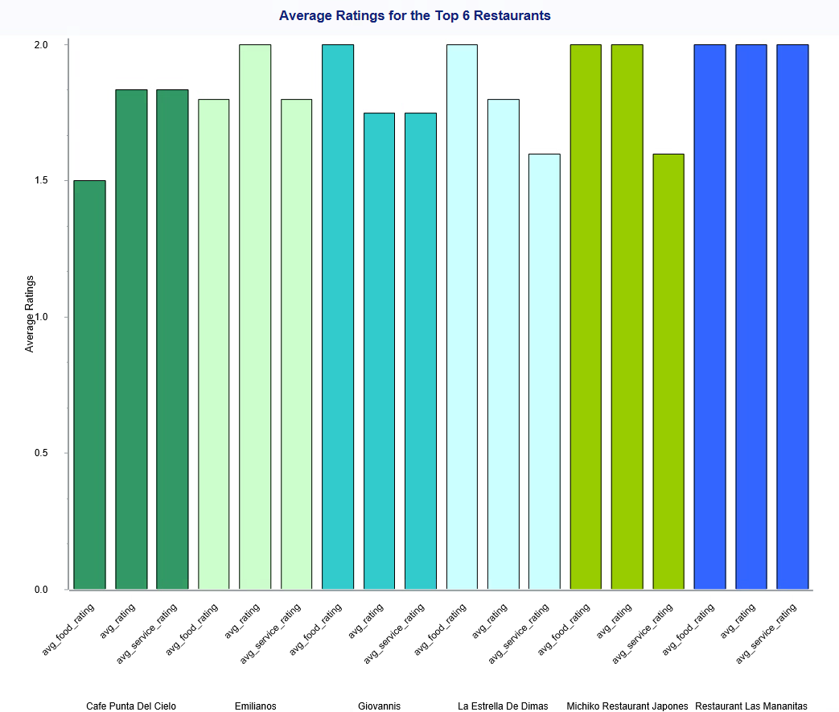
Top 6 Restaurants Based on Ratings (Rating >= 1.75 and Food Ratings >=1.8)

Slide 23
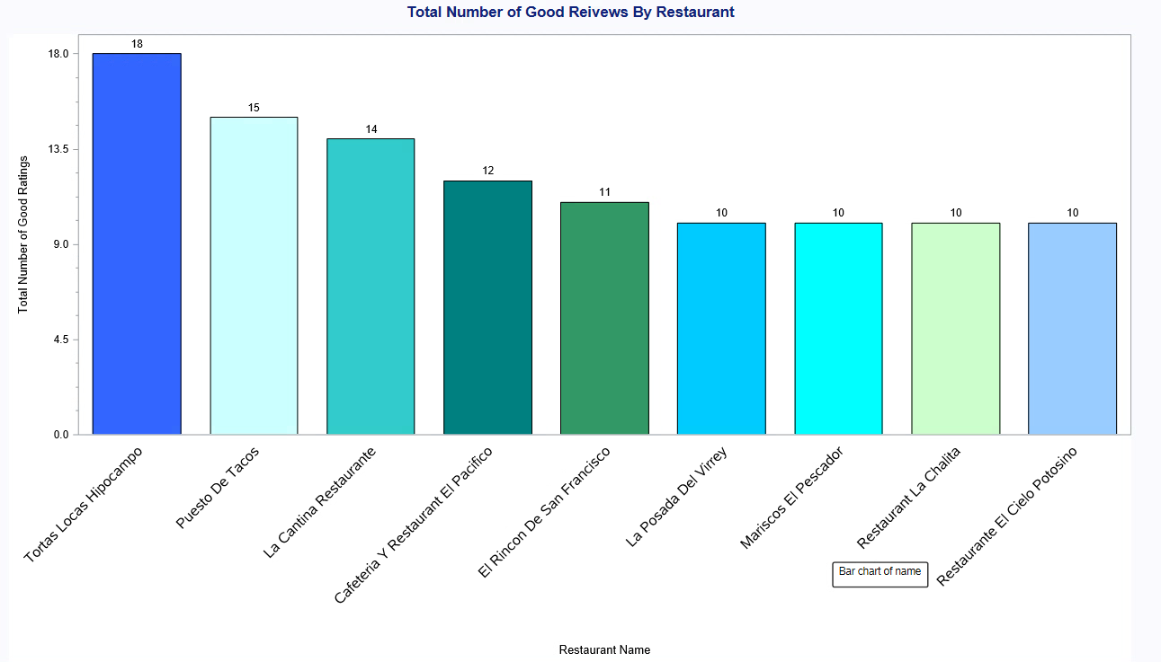
9 Highest Rated Restaurants Based on Good Reviews
(Total number of ratings >= 10)

Slide 24
Conclusion and Suggestions
Restaurant Las Mananitas is the highest rated restaurant in all categories.
Most user have medium budget for restaurants.
Formal setting restaurants usually have higher ratings.
More recent data might have different approach for rating, different payment methods.
Future analysis can include digital wallet payment (Apple Pay/Venmo), wifi availability, QR code menu, food delivery services, promotions, etc.
Online review can also be taken into consideration such as Yelp and Google.
Notes:
Speaker: Bella

Slide 25
Questions?

